Slide 1
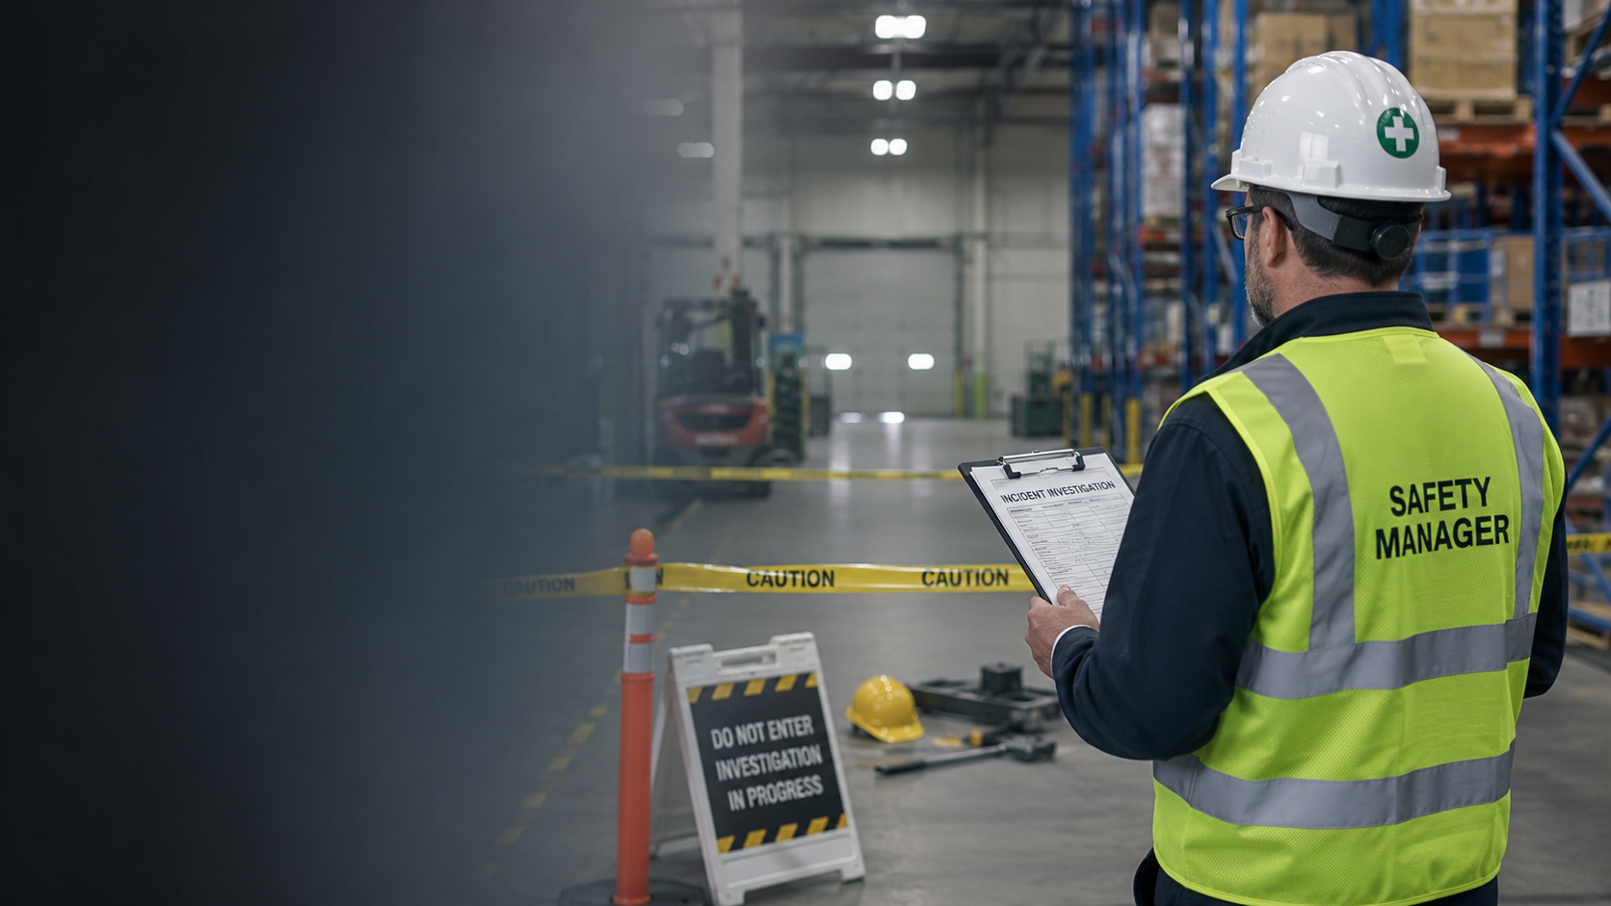
OHS Insider Webinar
Incident
Investigations
That Go Beyond
Worker Error
How Canadian OHS managers can strengthen root cause review, corrective action, and due diligence documentation
Notes:
Open by framing the promise. This is not a webinar about writing longer reports. It is about building investigations that identify the system conditions behind incidents and produce defensible evidence that risk was reduced.

Slide 2
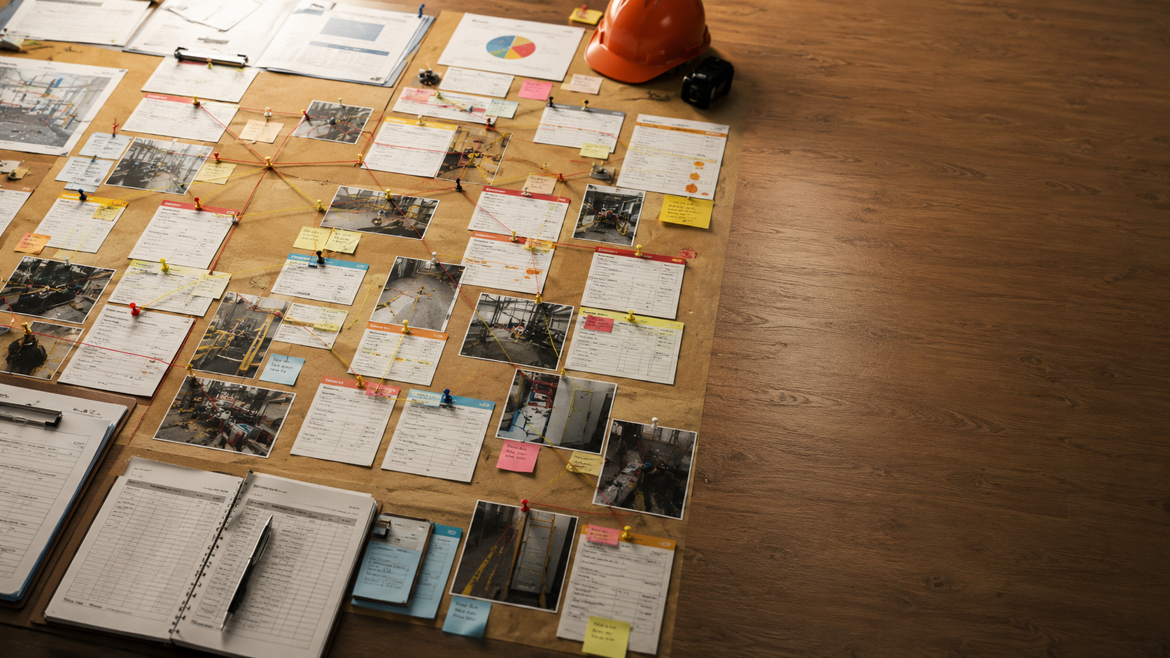
OPENING
OHS Insider
The file can be closed while the risk is still open
Most investigations answer what happened.
Stronger investigations prove what changed.
Completed form
≠
Controlled risk
A defensible investigation does not simply explain the event. It shows how the organization learned, acted, and verified control.
OHS Insider
2
Notes:
The opening tension is that administrative completion often gets mistaken for prevention. A file can look complete even though the control failed, the corrective action was weak, and no one verified whether the risk changed.

Slide 3


OPENING
OHS Insider
A practical roadmap for stronger investigations
1
Move beyond worker error
2
Find the failed control
3
Connect prior warnings
4
Match the corrective action
5
Verify effectiveness
From evidence → to controls → to verified change
OHS Insider
3
Notes:
Use this slide to preview the structure. The session is not meant to be theoretical. Each section gives OHS managers a way to ask better questions and close the gap between report completion and risk control.

Slide 4
INVESTIGATION MINDSET
OHS Insider
An investigation is a control cycle, not a form
Report
Capture facts
›
Investigate
Find causes
›
Correct
Change the system
›
Verify
Prove it worked
The purpose is not to close the investigation. The purpose is to close the risk.
OHS Insider
4
Notes:
A strong safety management system treats investigations as a control cycle. The work starts with reporting, but it should move through analysis, system change, and verification. The last step is what often gets missed.

Slide 5
FAILURE PATTERN
OHS Insider
How repeat incidents happen after “complete” investigations
1
Incident
2
Immediate cause
3
Worker error
4
Weak fix
5
Marked complete
6
Repeat event
›
›
›
›
›
Repeat incidents usually mean the earlier investigation stopped too early or the corrective action did not hold.
OHS Insider
5
Notes:
This is the loop that many workplaces recognize. It is not usually caused by indifference. It is often caused by a process that identifies the last visible failure, assigns a weak fix, and closes the item before anything has been tested.

Slide 6
CANADIAN OHS LENS
OHS Insider
What Canadian scrutiny asks after an incident
Hazard
Was it known or reasonably foreseeable?
Controls
Were controls selected, implemented, and practical?
Supervision
Was the work being verified in the field?
Warnings
Were prior incidents or near misses reviewed?
Follow-up
Was corrective action completed and verified?
A defensible file answers the questions an inspector, lawyer, insurer, or executive would ask six months later.
OHS Insider
6
Notes:
Do not frame this as legal advice. Frame it as a practical readiness lens. A serious or repeat incident will be evaluated through what the employer knew, what it did, and whether it verified that reasonable controls were effective.

Slide 7
WORKER ERROR
OHS Insider
Worker error may be true and still incomplete
The last visible action is not the same as the root cause.
Ask what made the error possible, predictable, tolerated, or not prevented by the system.
Worker error may explain what happened. It rarely explains why the system allowed it to happen.
OHS Insider
7
Notes:
This is the central theme of the webinar. Worker behaviour may matter, but if the investigation stops there, it often misses the conditions that made the behaviour likely and the controls that failed to prevent harm.

Slide 8
LANGUAGE SHIFT
OHS Insider
Change the question and you change the investigation
Blame-focused
Who failed?
Who broke the rule?
Who needs retraining?
Prevention-focused
What failed?
What control broke down?
What needs to change?
›
A prevention-focused investigation produces better corrective actions and stronger documentation.
OHS Insider
8
Notes:
Use this slide to give participants a simple diagnostic phrase. Who failed is not enough. What failed is the question that produces system learning.

Slide 9
INVESTIGATION PLANNING
OHS Insider
Plan the investigation before conclusions form
1. Secure the scene and preserve evidence
2. Separate facts from assumptions
3. Decide who needs to be interviewed
4. Review photos, records, equipment, and timeline before writing findings
Planning prevents the investigation from locking into the easiest explanation too early.
OHS Insider
9
Notes:
Emphasize sequence. If the team begins with conclusions, evidence will be interpreted to fit the first story. Planning makes the investigation disciplined and more defensible.

Slide 10
EVIDENCE
OHS Insider
Evidence should reconstruct the work system
Photos and measurements
Equipment and materials
Procedures and permits
Training and competency
Schedules and workload
Maintenance and inspection records
The file should show what was reviewed, not just what was concluded.
OHS Insider
10
Notes:
A defensible record shows the investigation was based on evidence, not assumptions. Evidence should help reconstruct how the work system operated at the time of the event.

Slide 11
INTERVIEW PRACTICES
OHS Insider
Interview for context, not confession
Ask for the conditions around the event
What task was underway?
What cues or information were available?
What pressure, interruption, or constraint was present?
What would make this happen again?
A blame-focused interview explains the worker. A context-focused interview explains the system.
OHS Insider
11
Notes:
Explain that the purpose is not to excuse conduct. The purpose is to understand the conditions that shaped decisions and whether the same decisions are likely under the same conditions.

Slide 12
INVESTIGATION DISCIPLINE
OHS Insider
Hindsight bias makes weak conclusions feel obvious
After the event
“They should have known better.”
“The correct choice is obvious.”
In the moment
Incomplete information
Real pressure
Competing priorities
≠
A good investigation puts the decision back into the conditions that shaped it.
OHS Insider
12
Notes:
This slide helps the audience avoid one of the most common errors in incident investigations. Once the outcome is known, it is easy to judge the worker harshly and miss the constraints that existed beforehand.

Slide 13
SCENARIO
OHS Insider
A slip is not just a slip
Weak finding
Worker failed to watch footing.
Look deeper
Surface contamination
Drainage and housekeeping
Footwear effectiveness
Prior slips or complaints
Stronger fix
Change the condition
Tighten inspections
Verify housekeeping
Review trend data
The investigation should identify the unsafe system condition, not only what the worker stepped on.
OHS Insider
13
Notes:
Use this as an applied example. A slip may involve worker attention, but the more useful investigation asks why the surface was unsafe and whether that condition had appeared before.

Slide 14
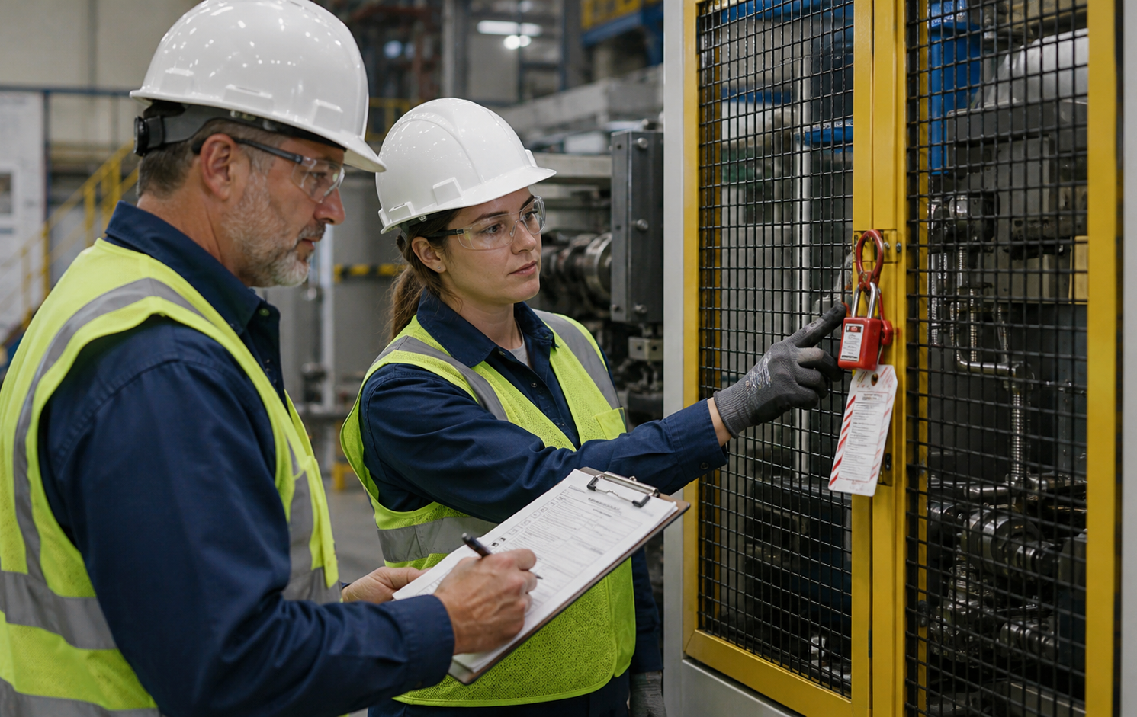
SCENARIO
OHS Insider
A lockout miss is a control warning
Questions to test the control system
• Was the procedure clear and practical?
• Were isolation points labelled?
• Did pressure shorten the process?
• Had similar near misses been reported?
Do not treat a hazardous energy near miss as simple negligence. Test whether the control system broke down.
OHS Insider
14
Notes:
Lockout is a strong example because the consequences can be severe. The investigation should evaluate the procedure, labelling, timing, supervision, and previous warning signs.

Slide 15
SCENARIO
OHS Insider
A lifting injury is not just poor body mechanics
Better questions
Load weight
Storage height
Frequency
Mechanical aids
Prior discomfort reports
Stronger corrective action
Reduce load weight
Change storage design
Add lift assist
Review trend data
The usual finding
“Improper lifting technique”
›
›
Technique may matter, but task design often matters more.
OHS Insider
15
Notes:
This example makes the framework relevant to musculoskeletal injuries. Training alone is often too narrow when the task itself is poorly designed.

Slide 16
DIAGNOSTIC LENS
OHS Insider
Where worker error hides system failure
Inattention
Fatigue, distraction, poor visibility, competing demands
Rushing
Production pressure, understaffing, impractical workflow
Poor judgment
Unclear rules, weak supervision, low practical competency
PPE not used
Availability, comfort, practicality, weak enforcement
Ask whether the same behaviour would likely happen again under the same conditions.
OHS Insider
16
Notes:
This slide helps safety managers translate common worker-error language into system questions. The behaviour is a starting point, not the end of the investigation.

Slide 17
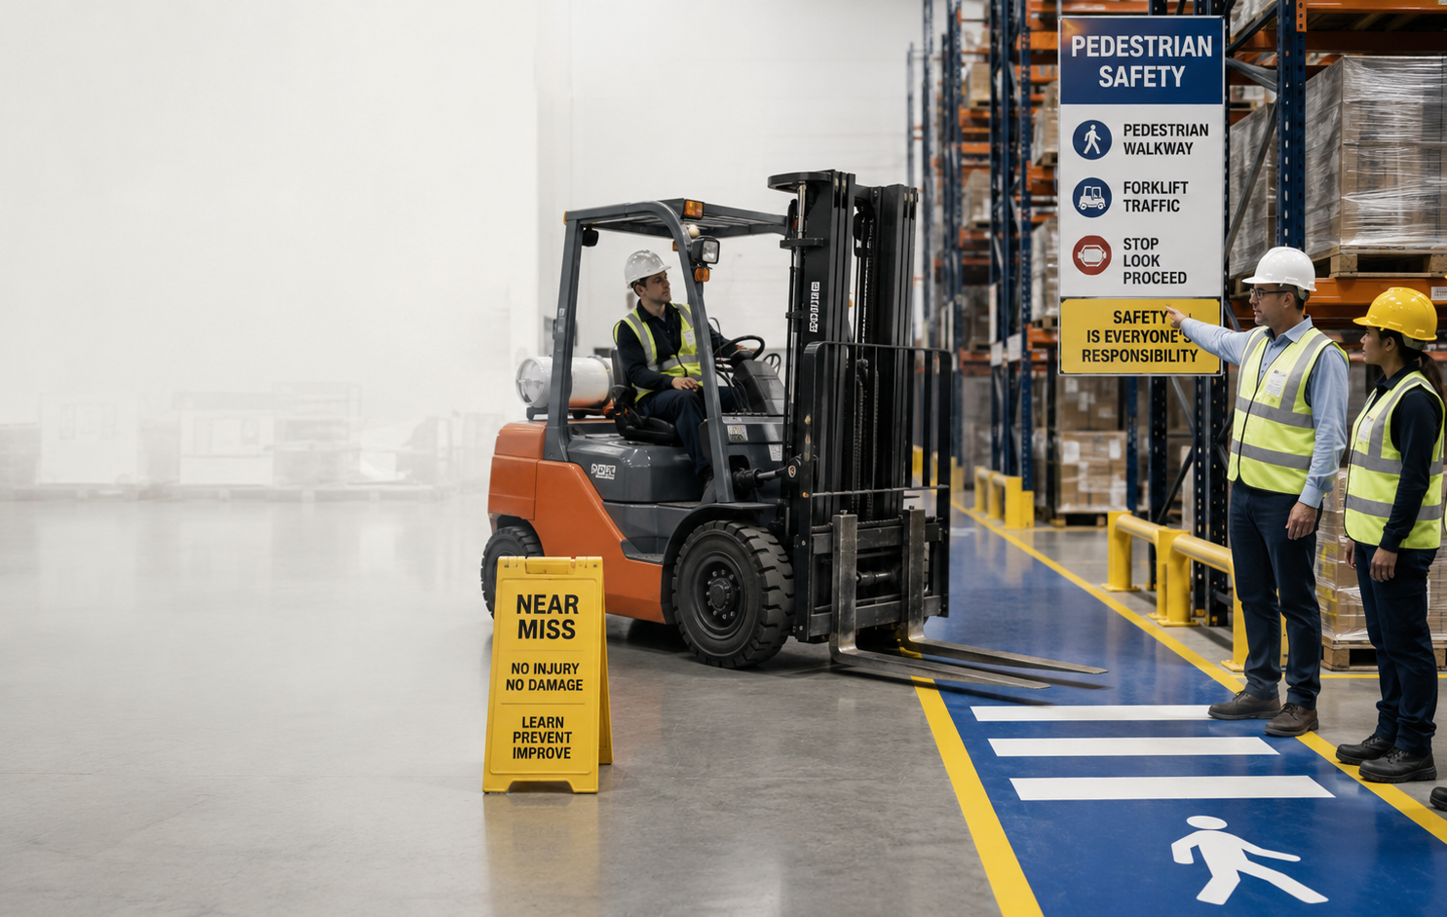
NEAR MISSES
OHS Insider
Near misses are pattern warnings
A near miss gives you evidence of weakness before the system produces injury.
Judge the event by what could reasonably have happened, not only by what did happen.
Luck is not a control.
OHS Insider
17
Notes:
The purpose of near-miss review is to learn before someone gets hurt. The outcome may be minor, but the credible consequence may be serious or fatal.

Slide 18
NEAR-MISS ESCALATION
OHS Insider
Escalate based on credible severity, not outcome alone
Monitor
Low potential severity
No critical control failure
No known pattern
Investigate
Moderate potential severity
Possible control weakness
Possible pattern
Escalate immediately
Serious or fatal potential
Critical control failure
Repeat pattern or luck event
If the only reason no one was hurt was timing or luck, treat the near miss as serious.
OHS Insider
18
Notes:
Not every near miss needs a full formal investigation. But high-potential events, critical control failures, repeat patterns, and luck-based escapes should be escalated.

Slide 19
CORE MODEL
OHS Insider
The Known Incident Pattern Review
Five questions that keep the investigation from stopping too early
1
Has this happened before?
2
What control failed?
3
What made it more likely?
4
Was the corrective action strong enough?
5
How will effectiveness be verified?
OHS Insider
19
Notes:
This is the main practical framework. The five questions force a pattern review, a control failure review, a contributing factor review, corrective action strength assessment, and verification planning.

Slide 20
QUESTION ONE
OHS Insider
Has this happened before?
Incidents
Near misses
First aid
Inspections
Maintenance
JHSC minutes
Complaints
Supervisor notes
You are not looking only for the same incident. You are looking for similar warning signs.
OHS Insider
20
Notes:
The goal is to identify whether the event was isolated or part of a developing pattern. Formal incident records are only one source of warning signs.

Slide 21
QUESTION TWO
OHS Insider
What control failed?
Every event should connect back to the control that was supposed to prevent or reduce it.
Elimination
Substitution
Engineering controls
Administrative controls
Supervision
Training / competency
PPE
Missing
Bypassed
Not verified
If the failed control is unclear, the corrective action will usually be too general.
OHS Insider
21
Notes:
This slide replaces the earlier jumbled control slide. Use it to connect investigations back to the hierarchy of controls. The control may be missing, bypassed, not practical, not understood, not verified, or simply too weak.

Slide 22
QUESTION THREE
OHS Insider
What made the behaviour or condition more likely?
Fatigue
Staffing
Workload
Production pressure
Time pressure
Communication
Unclear procedure
Poor layout
Equipment condition
Weather / lighting
Contractor coordination
Shift handoff
The point is not to excuse unsafe behaviour. The point is to understand what shaped it.
OHS Insider
22
Notes:
This is the systems-thinking part of the review. If the same behaviour would likely happen again under the same conditions, the investigation has not gone far enough.

Slide 23
QUESTION FOUR
OHS Insider
Was the corrective action strong enough?
Weak
Relies on memory or attention
Reminder
Memo
Toolbox talk
Generic retraining
Moderate
Improves the process but needs follow-through
Procedure update
Checklist
Supervisor sign-off
Targeted training
Strong
Changes the work or control system
Engineering control
Task redesign
Physical separation
Mechanical aid
Recurring verification
The higher the potential severity, the stronger the corrective action should be.
OHS Insider
23
Notes:
Corrective action strength is the bridge between investigation findings and prevention. Weak actions are not always wrong, but they are rarely sufficient for serious incidents, repeat incidents, or critical control failures.

Slide 24
QUESTION FIVE
OHS Insider
How will effectiveness be verified?
Completion means the action was done. Effectiveness means the action reduced risk.
Field observation
Worker interview
Supervisor verification
Inspection
Equipment check
Maintenance confirmation
Training validation
Competency check
Trend review / JHSC review
A procedure can be updated without being followed. Verification closes that gap.
OHS Insider
24
Notes:
Verification should be planned at the time the corrective action is assigned. The method must fit the action. Training should be validated, equipment changes should be inspected, and process changes should be observed in the field.

Slide 25
CORRECTIVE ACTION STATUS
OHS Insider
Do not confuse closure with control
Assigned
The action has an owner
Completed
The task has been done
Verified effective
Evidence shows risk has decreased
›
›
A completed action shows activity. A verified effective action shows control.
OHS Insider
25
Notes:
Encourage safety leaders to change their language. Complete should not be the same as closed. The stronger standard is verified effective.

Slide 26
DEFENSIBLE FILE
OHS Insider
Documentation that stands up to scrutiny
The file should show
• what happened and what evidence was reviewed
• who was interviewed and what context was learned
• whether similar warning signs existed
• what control failed or was missing
• what action was assigned, owned, completed, and verified
The file should tell a clear story of facts, causes, controls, action, verification, and learning.
OHS Insider
26
Notes:
Documentation is evidence. It should show a disciplined process, not simply a completed form. A file that explains facts, controls, decisions, and verification is much stronger than a thin blame-focused record.

Slide 27
LEADERSHIP REPORTING
OHS Insider
Leadership reporting should show active risk
Weak dashboard
• Number of incidents
• Number of investigations closed
• Percentage of corrective actions completed
Stronger dashboard
• Actions assigned, overdue, completed, and verified effective
• Repeat events by task, location, shift, supervisor, contractor, or control
• Critical control failures and high-potential near misses
A 95 percent closure rate can hide risk if no one knows whether the actions worked.
OHS Insider
27
Notes:
This is the leadership view. The metric that matters is not just how many actions are closed. It is how many are verified effective and whether repeat patterns are decreasing.

Slide 28
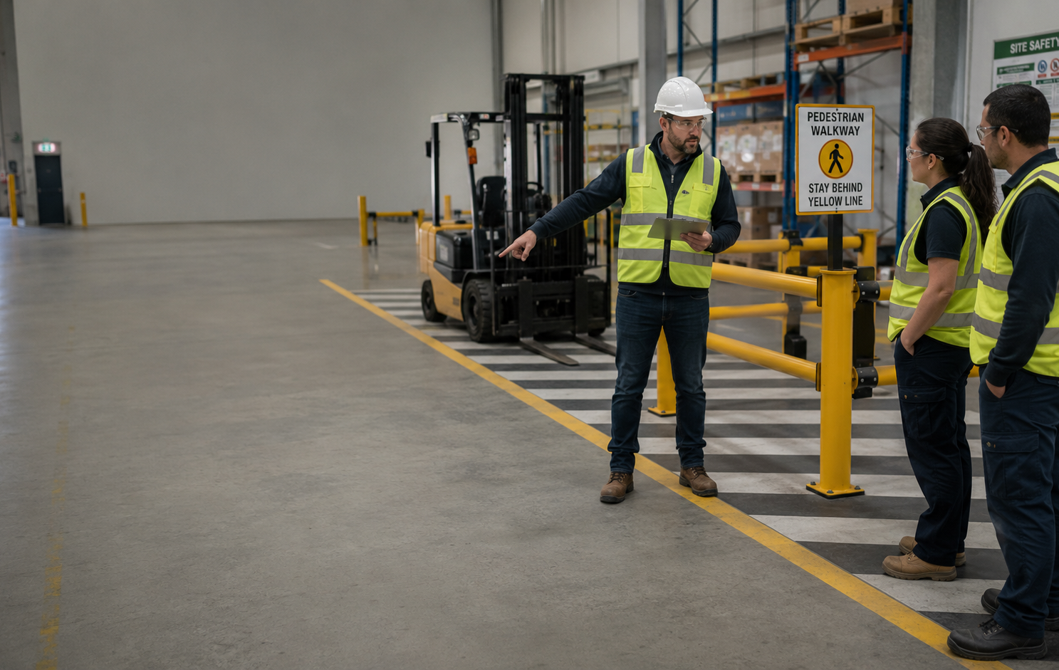
CASE DISCUSSION
OHS Insider
Apply the model to a warehouse strain injury
Scenario
A worker injures their shoulder manually moving boxes. The draft finding says “poor lifting technique.” The review finds two first-aid cases, one complaint about awkward reaching, and an inspection note about pallet placement.
The question is not whether technique mattered. The question is whether the system had already warned you.
OHS Insider
28
Notes:
Use this as the interactive case. Ask what prior warning signs existed, what control was missing, what factors made the injury more likely, what would be weak, and what would be strong corrective action.

Slide 29
IMPLEMENTATION
OHS Insider
A 30-day action plan for OHS managers
Week 1
Pick one recent incident and re-review it through the five questions.
Week 2
Identify repeat patterns across near misses, first aid, inspections, and complaints.
Week 3
Rate open corrective actions as weak, moderate, or strong.
Week 4
Add verification owner, method, date, and evidence required.
Start with one file. The goal is to change the investigation habit, then the system.
OHS Insider
29
Notes:
This slide turns the webinar into action. The first step is not overhauling every form. It is taking one recent investigation and testing whether it answered the deeper questions.

Slide 30
BEFORE CLOSING THE FILE
OHS Insider
Final checklist for OHS managers
Immediate and system cause identified?
Prior warnings reviewed?
Failed control identified?
Contributing factors tested?
Corrective action matched to cause?
Action strong enough for severity?
Owner has authority?
Effectiveness verified?
Repeat risk status clear?
Where else could this happen?
A defensible investigation proves the organization learned, acted, and verified that risk was controlled.
OHS Insider
30
Notes:
Use this as the closing checklist. The questions are intentionally practical and should be asked before an investigation or corrective action is treated as closed.

Slide 31
Q&A
OHS Insider
Questions and discussion
1. Where do your investigations most often get stuck?
2. Do corrective actions get verified or just marked complete?
3. Are near misses escalated by credible potential severity?
4. Could your current incident file withstand review after a repeat event?
Thank you
OHS Insider
31
Notes:
Invite questions and ask participants which part of their investigation process they want to strengthen first.

Slide 32
REFERENCES
OHS Insider
Selected sources and framework inputs
OHS Insider special report Why Investigations Fail to Prevent Repeat Incidents
CCOHS incident investigation guidance
CCOHS due diligence guidance
WorkSafeBC employer incident investigation guidance
WorkSafe Saskatchewan incident investigation guidance
R. v. Kazenelson and related Metron case commentary
Note This presentation is a practical safety-management resource, not legal advice.
OHS Insider
32
Notes:
The final slide identifies the major framework inputs and includes the legal advice disclaimer.

