Slide 1
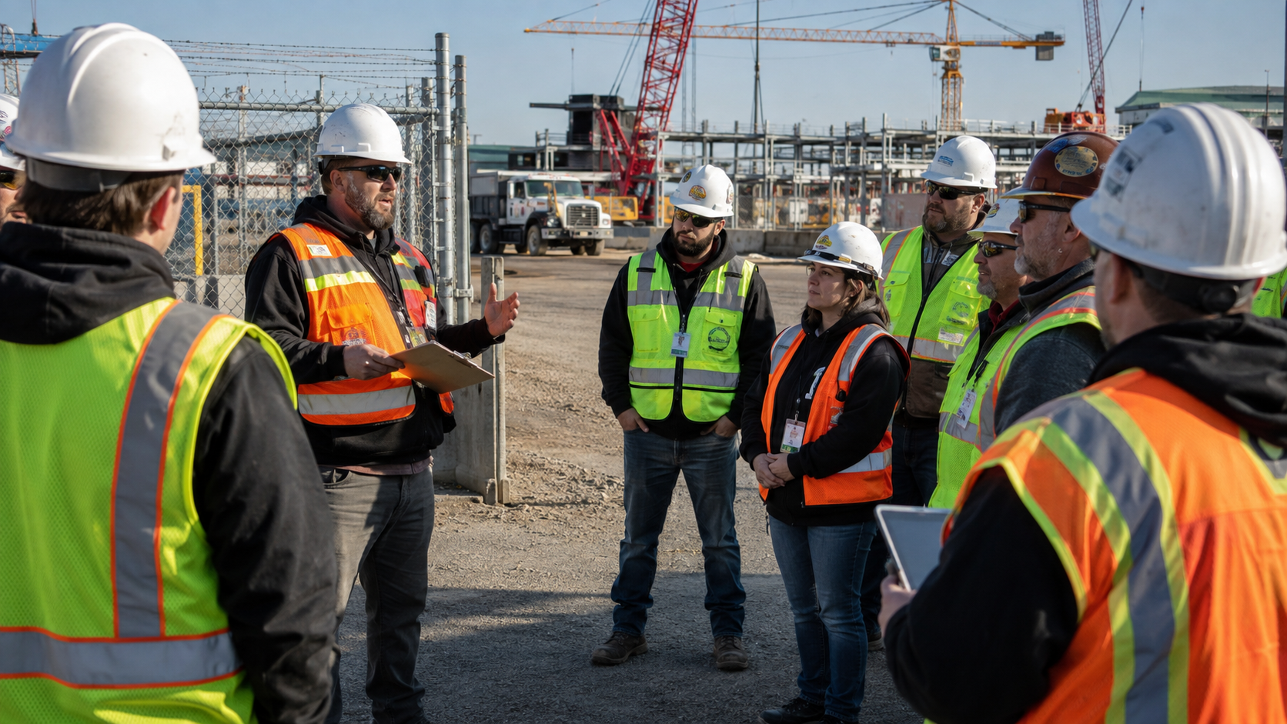
AUGUST 12 WEBINAR
Contractor Safety Oversight
Without False Assumptions
Contractors bring expertise. They do not bring immunity from coordination, communication, and host-site risk.
9:00 AM PT • OHS Insider
OHS Insider
Notes:
This deck uses a completely different framing from the LMS session. The core metaphor is an assumption autopsy: where did the safety system assume too much?

Slide 2
The case file always starts with a sentence.
“We thought they had that covered.”
That sentence is usually not malicious. It is a sign that ownership, communication, or verification was never made explicit.
OHS Insider
Notes:
Use this to reset the audience. Contractor risk is rarely caused by one careless decision. It usually comes from untested assumptions.

Slide 3
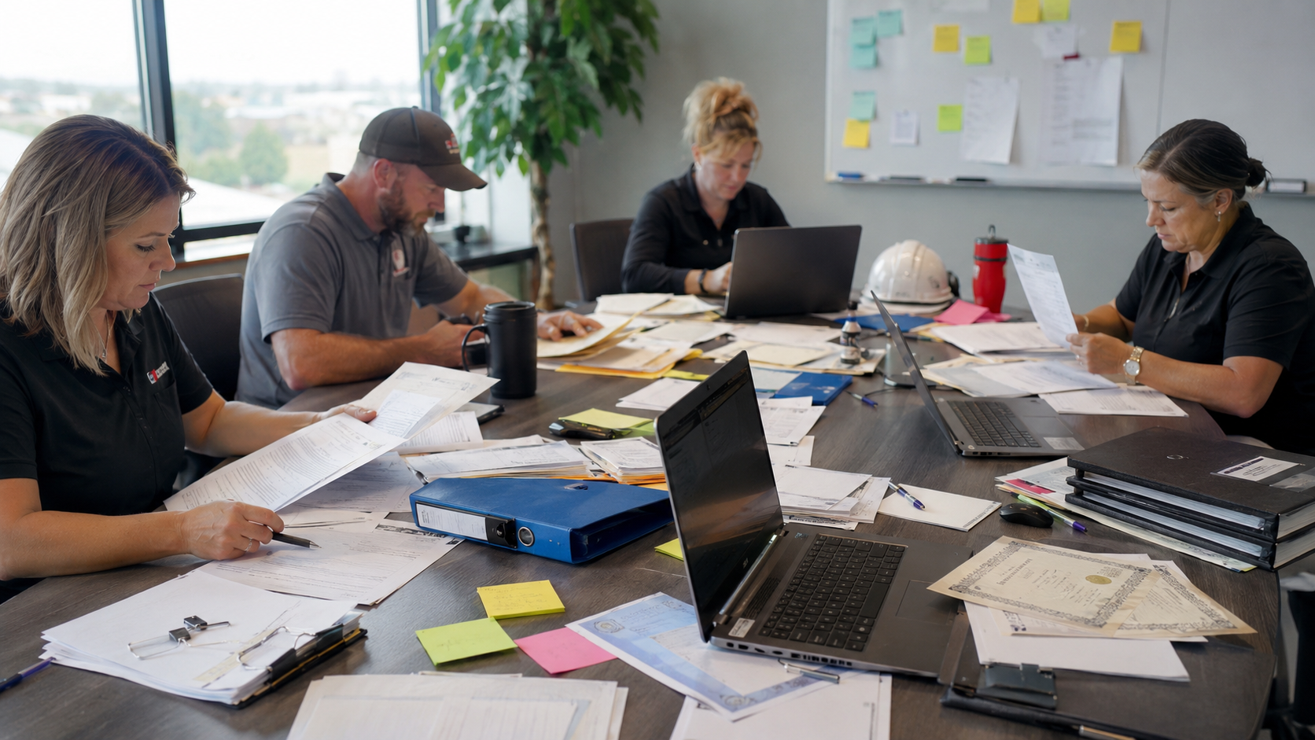
Five assumptions that fail.
1. They are qualified
2. They know our site
3. Their supervisor is watching
4. Subcontractors are covered
5. No news means no problem
OHS Insider
Notes:
Preview the structure. Unlike the LMS deck, this webinar walks through failed assumptions and replaces them with specific controls.

Slide 4
Shared work creates shared exposure.
In the U.S., OSHA’s multi-employer policy can make more than one employer citable on the same worksite. In Canada, duties vary by jurisdiction, but coordination, control, and due diligence still matter.
Do not reduce contractor oversight to “their employees, their problem.”
Sources: OSHA Multi-Employer Citation Policy CPL 02-00-124; CCOHS contractor health and safety due diligence framework.
OHS Insider
Notes:
Emphasize that this is not legal advice. The practical rule is simple: if you control the site, sequence, access, information, or permit conditions, you need a coordination system.

Slide 5
Oversight is a lifecycle, not a gate badge.
1
2
3
4
5
6
Select
Scope
Orient
Coordinate
Observe
Close
Can they do this safely?
What exactly will they do?
What must they know here?
Who owns the interface?
What is happening now?
What did we learn?
OHS Insider
Notes:
This replaces a single orientation checklist with a contractor lifecycle. Each step answers a different risk question.

Slide 6
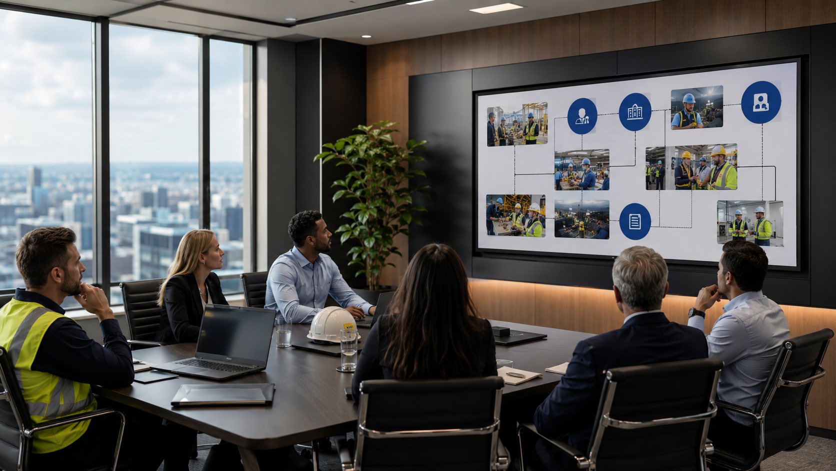
Prequalification is not a trophy case.
It is a risk screen tied to the actual work.
Similar work
Qualified supervision
Current training
Incident history
Equipment controls
Subcontractor control
OHS Insider
Notes:
Push against the binder mentality. Prequalification should not be generic. It should be proportional to the work, exposure, and site interface.

Slide 7
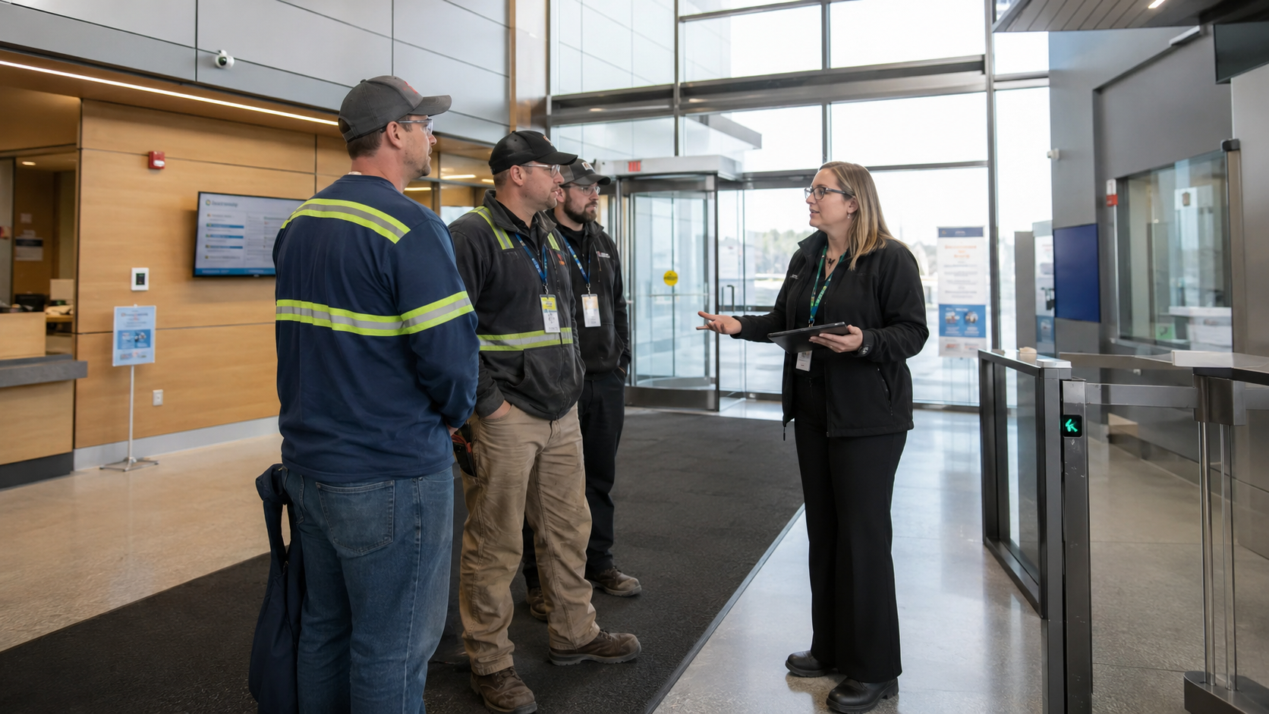
Site-specific means what only your site can know.
Traffic flow. Restricted areas. Emergency response. Simultaneous operations. Known hazards. Local rules. Stop-work contacts.
OHS Insider
Notes:
A contractor may be technically competent and still be unprepared for your site. This is where host employer knowledge becomes critical.

Slide 8
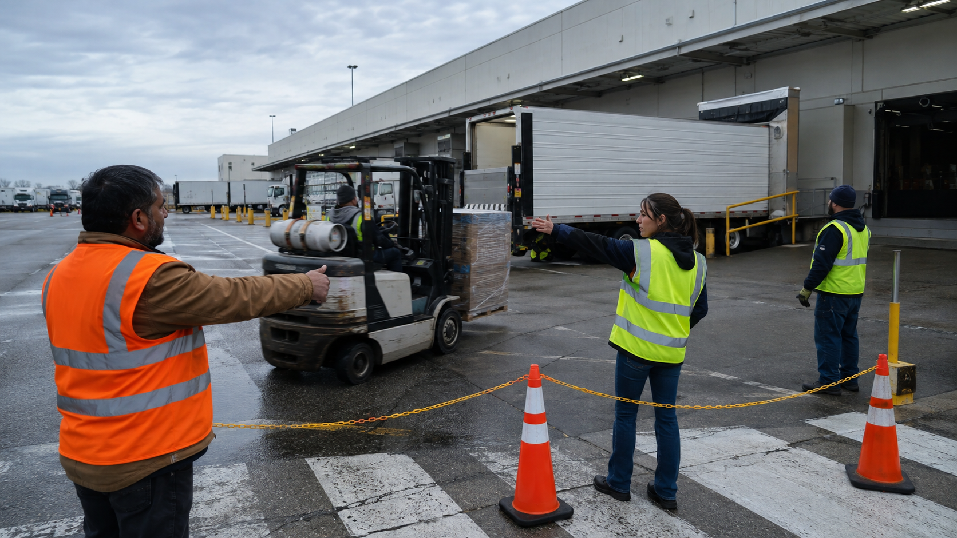
The dangerous part is the interface.
Your forklift. Their driver. Your dock. Their schedule. Your traffic pattern. Their pressure.
OHS Insider
Notes:
Use loading docks, shutdowns, maintenance outages, and construction projects as examples. The risk lives where two systems meet.

Slide 9
Name the host contact before work starts.
Question
Owner
Who can stop the work?
Named person
Who resolves a field conflict?
Named person
Who gets deviation reports?
Named person
Who confirms closeout?
Named person
OHS Insider
Notes:
A named host contact is boring, but it prevents confusion when field conditions change or a contractor challenges a control.

Slide 10
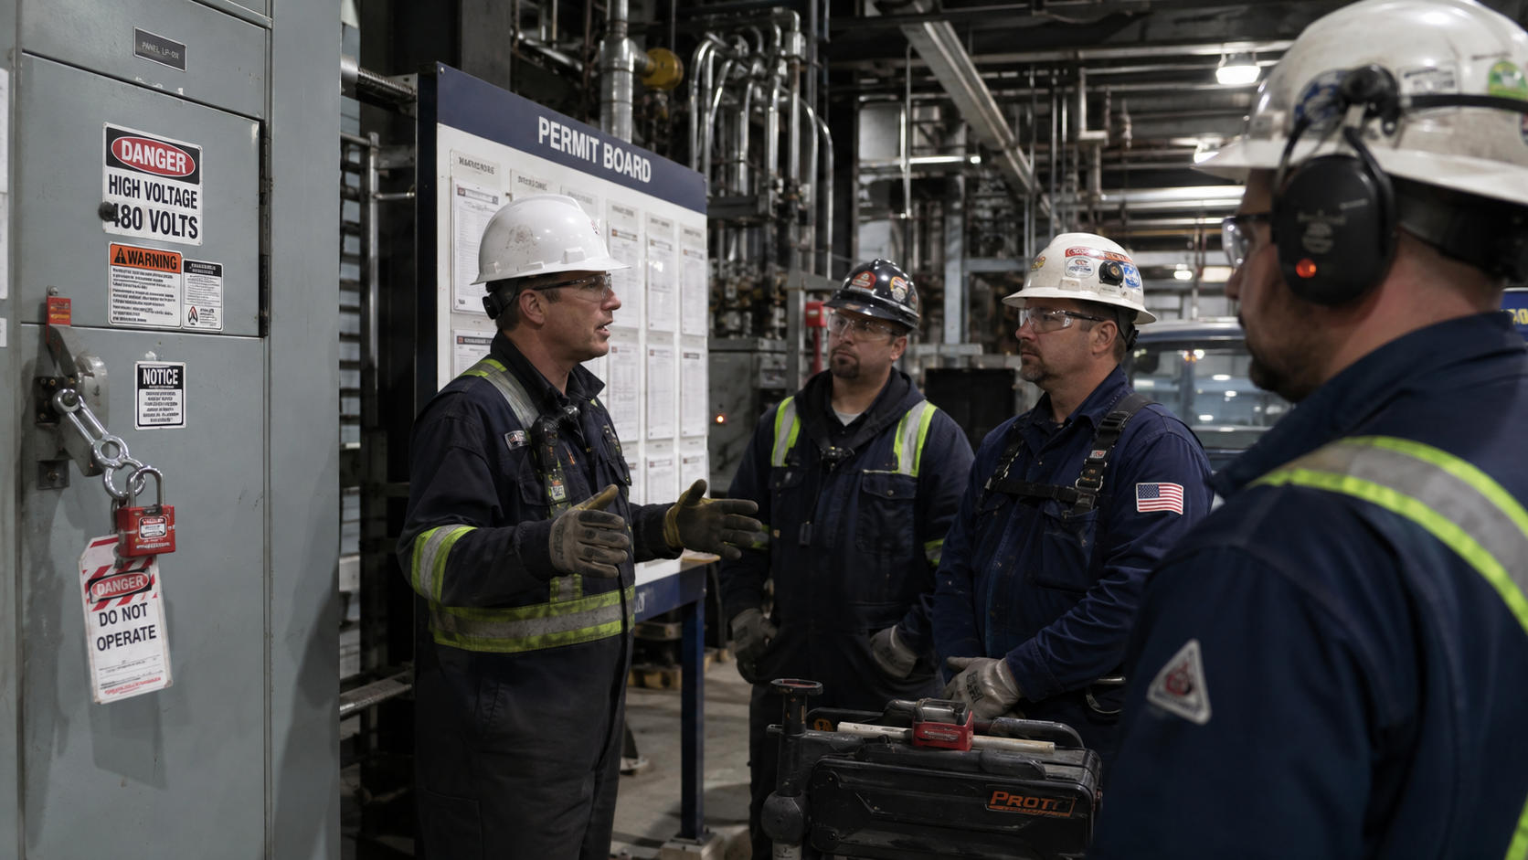
Observation is not babysitting.
It is how you confirm that the coordinated plan is surviving contact with the work.
Presenter context: OSHA communication and coordination guidance; CCOHS contractor safety due diligence principles.
OHS Insider
Notes:
Make this distinction: oversight is not taking over the contractor’s work. It is checking the safety interfaces and host-site controls.

Slide 11
Closeout is where the next job gets safer.
What changed?
What did we stop?
What was unclear?
What needs to be added to the next scope?
Do not let contractor learning disappear when the crew leaves.
OHS Insider
Notes:
Many companies orient contractors but do not learn from contractor work. Closeout feeds the next pre-job plan.

Slide 12
The 30-day assumption reset.
Week 1
List contractor types and risky interfaces
Week 2
Update prequalification and site orientation triggers
Week 3
Name host contacts and stop-work authority
Week 4
Pilot field observation and closeout notes
OHS Insider
Notes:
This gives the audience a practical implementation path.

Slide 13
The takeaway is simple.
Trust the contractor.
Verify the interface.
That is how oversight stays practical, respectful, and defensible.
OHS Insider
Notes:
Close with a practical, non-adversarial message: verification is not distrust. It is coordination.

Slide 14
Presenter source notes
RICKT@BONGARDE.COM
RICK TOBIN
OHS Insider
Notes:
These are presenter references and should not be read during the webinar.

