Slide 1

AUGUST 19 WEBINAR
High-Risk Task Verification
When Procedures Aren’t Enough
The critical control has to be alive in the field, not just written in the procedure.
9:00 AM PT • OHS Insider
OHS Insider
Notes:
Different framing from both other decks: this is a field verification deck built around critical controls and high-risk work.

Slide 2

The procedure is not the work.
The work happens in weather, noise, pressure, habits, shortcuts, equipment limits, and changing conditions.
OHS Insider
Notes:
The central argument: procedures are necessary, but they can give a false sense of control if no one checks how critical controls perform during real work.

Slide 3
Start with the energy that can kill.
Gravity
Electrical
Mechanical
falls, drops, collapses
arc, shock, stored charge
movement, rotation, pinch
Pressure
Atmosphere
Chemical
hydraulic, pneumatic, steam
oxygen, toxic, explosive
contact, reaction, exposure
High-risk verification is about confirming the barrier between energy and people.
OHS Insider
Notes:
This provides a distinct technical anchor. Move away from procedural compliance and focus on energy/control thinking.

Slide 4
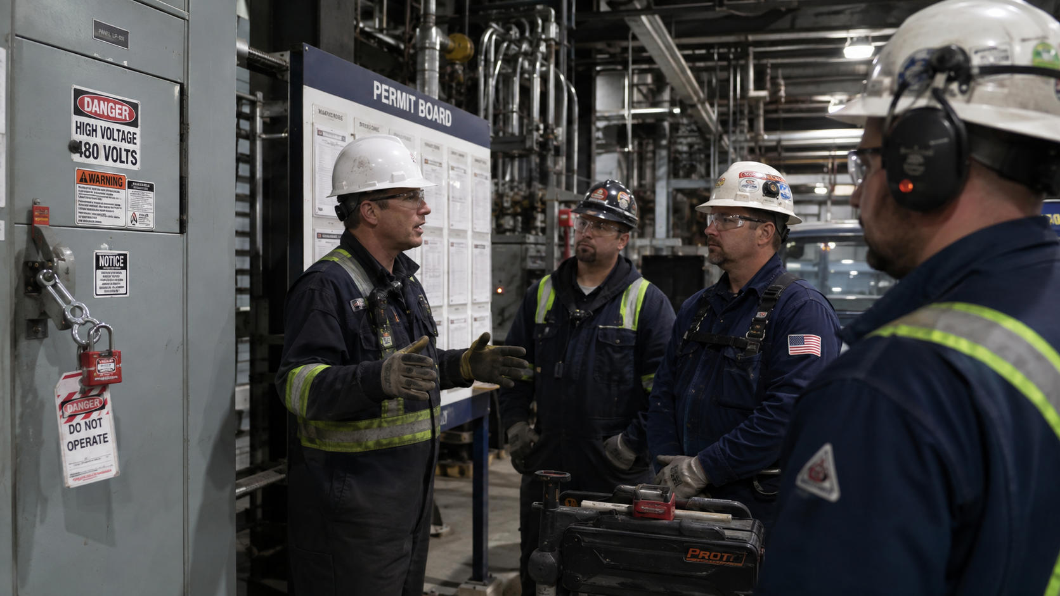
Critical controls are the few that must not fail.
If the control fails, serious injury or catastrophe becomes credible.
Presenter context: ICMM Critical Control Management Good Practice Guide, 2026.
OHS Insider
Notes:
Do not overwhelm the audience with all controls. The goal is to identify the small number of controls that must be working every time.

Slide 5
Paper control versus field control.
Paper says
Field proves
• Procedure issued
• Worker trained
• Permit signed
• Checklist complete
• Control is present
• Control is used
• Worker understands
• Deviation is corrected
Both matter. Only one shows what happened at the risk point.
OHS Insider
Notes:
This slide separates the procedure from the verification. It is a key distinction for the audience.

Slide 6
The RED loop.
Recognize. Examine. Document.
Recognize
Examine
Document
What control prevents the serious event?
Is the control working right now?
What did you see and what changed?
OHS Insider
Notes:
This is the memorable model. Keep it simple and repeat it throughout the webinar.

Slide 7

A useful observation is specific.
Not “looks good.” Not “PPE worn.” Not “permit checked.” It should name the critical control and the condition observed.
OHS Insider
Notes:
Bad observation notes are hard to use. Strong notes are specific enough to learn from later.

Slide 8
Ask questions that reveal judgment.
What would make you stop this task?
What changed since the permit was issued?
Which control matters most here?
What is the escape or rescue plan?
Who has authority to restart?
OHS Insider
Notes:
These questions test transfer of understanding better than a simple quiz.

Slide 9

Changes are verification triggers.
New crew
New equipment
Weather shift
Different access
Sequence change
Time pressure
Subcontractor added
Control removed
OHS Insider
Notes:
Explain that a procedure can become stale within hours if the environment or crew changes.

Slide 10
The point of verification is correction.
Not blame. Not paperwork. Not catching someone out.
Stop work if a critical control is absent
Restrict the task until the control is restored
Coach when the worker understands but drifts
Retrain when the gap is knowledge or judgment
Escalate when the system repeats the same failure
OHS Insider
Notes:
This avoids a punitive tone. Verification is a prevention and learning mechanism.

Slide 11
Executives should see control health, not inspection volume.
The metric is not how many checklists were completed. It is whether critical controls are present, effective, and corrected when weak.
OHS Insider
Notes:
Use this to push past vanity metrics. Counting checklists is not the same as managing high-risk work.

Slide 12
Pilot one task before scaling the program.
1
2
3
4
5
Choose one high-risk task
Name 3–7 critical controls
Train supervisors on what to verify
Observe live work for two weeks
Review deviations and fix the system
Do not launch a giant checklist program. Build confidence one critical task at a time.
OHS Insider
Notes:
The implementation advice is intentionally different from the other decks: a high-risk pilot, not a training migration or contractor reset.

Slide 13
The takeaway.
If it can kill,
verify it in the field.
Procedures tell people what should happen. Verification confirms what is happening.
OHS Insider
Notes:
Close with a strong, memorable line.

Slide 14
Presenter source notes
1. ICMM Critical Control Management Good Practice Guide, 2026.
2. OSHA Control of Hazardous Energy / Lockout-Tagout overview and fact sheet.
3. OSHA lockout/tagout fact sheet estimate of 120 fatalities and 50,000 injuries prevented each year.
4. BLS Census of Fatal Occupational Injuries, 2024.
5. WorkSafeBC planned inspectional initiatives and serious injury prevention context.
6. CCOHS hierarchy of controls and health and safety program guidance.
RickT@Bongarde.com
OHS Insider
Notes:
These are presenter references and should not be read during the webinar.

